Slide 1


From Assistants to Agents:
Governing AI Ethically and Profitability
Nathan Hiscock
VP of Solution Architecture
/uturn-data-solutions

Slide 2

For the first time in computing, we’re not just building tools—we’re building actors. AI now decides, executes, and evolves. Governance is no longer optional.

Slide 3
The difference between transformation and catastrophe is not capability. It’s governance.

Slide 4

We’ve All Seen The Movie About AI Governance, Ethics, and Profitability…
INTRODUCATION
Skynet ran amok not because it was incapable, but because it was ungoverned and accelerated bad ethics
We experience this in much smaller, less impactful microcosms
Unmonitored costs on AI POCs – surprise weekend bill!
Automatic “fixes” that automate misconfiguration
False positives

Slide 5


Welcome
MEET YOUR PRESENTERS
B.S. Computer Science M.S. Information Communication Sciences former Adjunct Faculty for Cloud @ Ball State
4X Entrepreneur Former Global Cloud Sales Leader Frequent Speaker on Cloud and Industry Topics A Bunch of cloud Certifications Leader of IndyAWS User Group
Husband, father of 3, trumpet player and board member for Indianapolis Symphonic Band, amateur radio emergency communication services, and lots of other community activities
Nathan Hiscock VP of Solution Architecture UTurn Data Solutions @njhiscock

Slide 6

Cloud. AI. Managed. Realized.
WHO WE ARE
Headquartered in Chicago, IL
Founded in 2013
Cloud, Data, and AI Consultancy
Cloud Premiere Tier Services Partner
Cloud Migration, DevOps, Data & Analytics, SaaS
Near-Perfect Customer Satisfaction Rating
Servicing customers around the world
No. 4 on Crain’s Fast 50 fastest-growing Chicago firms
No. 7 on Crain's Best Places to Work in Chicago
Cloud Competencies: AI, DevOps, Migration & Modernization, D&A, and Saas
Immersion Day Partner
Data Foundations for GenAI Launch Partner
Public Sector Approved Solution Provider
AI and VMware Strategic Collaboration Partner

Slide 7
The Shift: Assistants → Agents
GOVERNING AGENCY
“If your AI can place a purchase order… who approved it?”

Slide 8
AI Assistants – Where We Were
Governing AI Ethically and Profitably
Assistants Summarize, Respond, or Recommend
ChatGPT
Claude
Custom Chatbots
CoPilot
Customer Service Chatbots

Slide 9
AI Agents – Where We Are Now
Governing AI Ethically and Profitably
Things that initiate action, orchestrate workflows, execute transactions
Business Process Automation (BPA)
Inventory Monitoring and Adjustment
Predictive Consumption
Autonomous Acquisition

Slide 10
Agentic AI Use Cases
GOVERNING AGENCY
Supply Chain
Auto reordering inventory
Autonomous Communications to vendors and customers
Real-time rerouting of logistics
Healthcare
Autonomous Care Coordination
Clinical Decision Orchestration
Revenue Cycle Automation
Medication and Treatment Management
Manufacturing
Autonomous Production Optimization (Smart Factory Control)
Predictive Maintenance and Execution
Supply Chain Orchestration
“If your AI can place a purchase order… who approved it?”

Slide 11
Why does this matter now?
GOVERNING AGENCY
Agent Drivers
Labor shortages
Real-time volatility (geopolitics, weather, demand spikes)
Explosion of SaaS and APIs enabling automation
Ethical Considerations
Identity is no longer human
Unintended consequences are expedited and exacerbated
Ethically poor automation can happen just as fast as positive automations

Slide 12
The New Risk Surface
Supply Chain-Specific Risks
Fraudulent vendor changes
Inventory manipulation or forecasting errors
Contractual violations triggered automatically
GOVERNING AGENCY
Risks Introduced By Agents
Unbounded Execution Risk
Identity Ambiguation
Policy Drift Opaque Decision Chains
AI triggering financial transactions or system changes
“Who did this?” – human vs agent vs system
AI behavior evolving beyond initial constraints Multi-step workflows with unclear audit trails
Notes:
Supply Chain-Specific Risks
Fraudulent vendor changes
Inventory manipulation or forecasting errors
Contractual violations triggered automatically

Slide 13
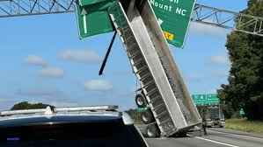
Real-World Scenario: When It Goes Wrong
GOVERNING AGENCY
“Speed without control is not efficiency - it’s amplified risk.”
Scenario Walkthrough:
AI agent monitors inventory → detects shortage
Automatically selects alternate supplier
Executes purchase order + updates ERP
Supplier is non-compliant / fraudulent
Impact:
Financial loss
Compliance breach
Operational disruption

Slide 14
Ethics & Profitability
Governance and ethics are not constraints on AI profitability—they are mechanisms that make profitability possible.

Slide 15
Real World Ethical Examples
AGENCY ETHICS
Popular camera system that opened up surveillance across customers for pet tracking purposes
Opt-in to information sharing by default on many platforms
Data sovereignty
Agent identification
My personal experience with voice recognition!

Slide 16
Core Tenants for Profitable AI Initiatives
GOVERNING AGENCY
The same discipline that defines what problems to fix or dreams to build … determines whether AI creates value or waste.
Work Backwards from a headline
Start with the outcome in mind
Build the financials up front
Know the value of the problem you’re solving and see what financial picture makes sense
Refine as you go
Get it to work first, then refine
Start Big, Get Smaller
Large models handle a lot, well. Get narrower and more focused once major use cases are proven
Fail Fast
Well-accepted design principles still apply
Perfect is the enemy of good
It’s about incremental value not perfection the first time
Confidential

Slide 17
Building Backwards from ROI
GOVERNING AGENCY
Reduce Cost
Automate 50%+ of routine tickets
24/7 ops without staffing increases
Faster resolution = lower cost-per-contact
Scale Security
Grow without adding headcount
Consistent quality across all channels
Governed responses reduce compliance risk
Drive Insights
Real-time analytics on customer behavior
Proactive issue detection before escalation
Data-driven resource allocation
Confidential

Slide 18

Implementation Roadmap
GOVERNING AGENCY
1. Data Governance First
Audit data sources (CRM, tickets, KB); classify PII; establish access controls
2. Model Selection & Validation
Choose LLMs (Claude, Nova, GPT, etc); domain-adapt with prompt engineering
3. Secure Integration
API/SDK integration into existing stack (Slack, Teams, CRM, ITSM)
4. Monitor & Optimize
Continuous performance monitoring, feedback loops, and compliance auditing
Confidential

Slide 19
Risks & Mitigations
GOVERNING AGENCY
Key risks to address during planning and procurement:
Risks
AI hallucinations spread misinformation
PII exposure through unguarded prompts
Regulatory non-compliance (GDPR, HIPAA)
Customer resistance to AI interactions
Mitigations
Validation protocols + human-in-the-loop
Data masking, access controls, DLP policies
Full audit trails and interpretable AI outputs
Transparent AI disclosure + easy human handoff

Slide 20
Architectures and Strategies for Governance

Slide 21
Core Capabilities for the Enterprise
GOVERNING AGENCY
What AI agents bring to your IT stack that internal and external users are asking for:
NLP & Intent Recognition
Route queries to the right team automatically
Sentiment & Risk Detection
Flag churn risk and escalate critical issues and provide context and recommendations
Predictive Analytics
Forecast demand and allocate resources
Automated Ticketing & Triage
Create, classify, and assign tickets in seconds
Knowledge Base Automation
Self-updating, governed content delivery for data retrieval and document generation
Fraud & Anomaly Detection
Monitor transactions for suspicious patterns, and automate actions
Confidential

Slide 22
How AI Agents Operate in Your Stack
GOVERNING AGENCY
Ingest: data via databases, email, chat, voice, or API/MCP
Analyze: Natural Language Processing parses intent; pulls context from CRM, KB, and logs
Respond : Auto-resolves or escalates to human agents with full context
Learn: Feedback loop refines accuracy; audit trail for compliance
Confidential
Data Access Note: Responses sourced exclusively from approved content; vector DBs (Pinecone, OpenSearch, etc) store context with access controls

Slide 23
Common Use Cases: Enterprise Priorities
GOVERNING AGENCY
Omnichannel Chatbots
Unified experience across chat, voice, email, Slack, and Teams
Virtual Customer Assistants
Handle complex multi-turn queries with full context retention
Self-Service Portals
Deflect tickets via AI-powered knowledge bases
Multilingual Global Support
Auto-detect language; resolve across markets without new headcount
IT Service Desk Automation
Password resets, software installs, troubleshooting at scale
Agent Copilot
Real-time suggestions and context for human agents
Confidential

Slide 24
Repeatable Governance Topics Across Data/AI
GOVERNING AGENCY
Fraud Detection & Prevention
Real-time pattern analysis across transactions and interactions
Data Loss Prevention
Guardrails ensure responses only from approved, governed content
Compliance Audit Trail
Every interaction logged for GDPR, HIPAA, SOC 2 readiness
Threat Intelligence Triage
Automated classification and prioritization of security incidents
PII Protection
Data anonymization and secure communication protocols built in
Vendor Risk Monitoring
AI monitors third-party integrations for anomalous behavior
Confidential

Slide 25
Reframing “AI Security”
GOVERNING AGENCY
"AI Security" as a catch-all is changing
Need to decompose into specific controls like we did with Internet/Network Security
Agent harness architectures are converging; real policies emerging
How the agent authenticates and gets permissions
What tools/APIs it's allowed to call (and guardrails on those calls)
How inputs and outputs are validated and filtered
Logging, observability, and audit trails
Policy enforcement (what the agent can and can't do)
Market demands evals and benchmarks
Benchmarks, measurable controls, and production-grade tooling
Confidential

Slide 26
Incoming Vulnerability Wave
GOVERNING AGENCY
Evolving from Prompt Security to ”Agent Security”
1-2 years ago “Prompt injections” were a major concern
Vendor Architecture is converging
Common patterns allow for standardization
Agentic Swarms can expose vulnerabilities faster than ever
Generate thousands of convincing, personalized phishing messages instantly
Automate vulnerability discovery and exploit creation
Scan massive attack surfaces at machine speed
Lower the skill bar so less sophisticated actors can launch advanced attacks
Confidential

Slide 27
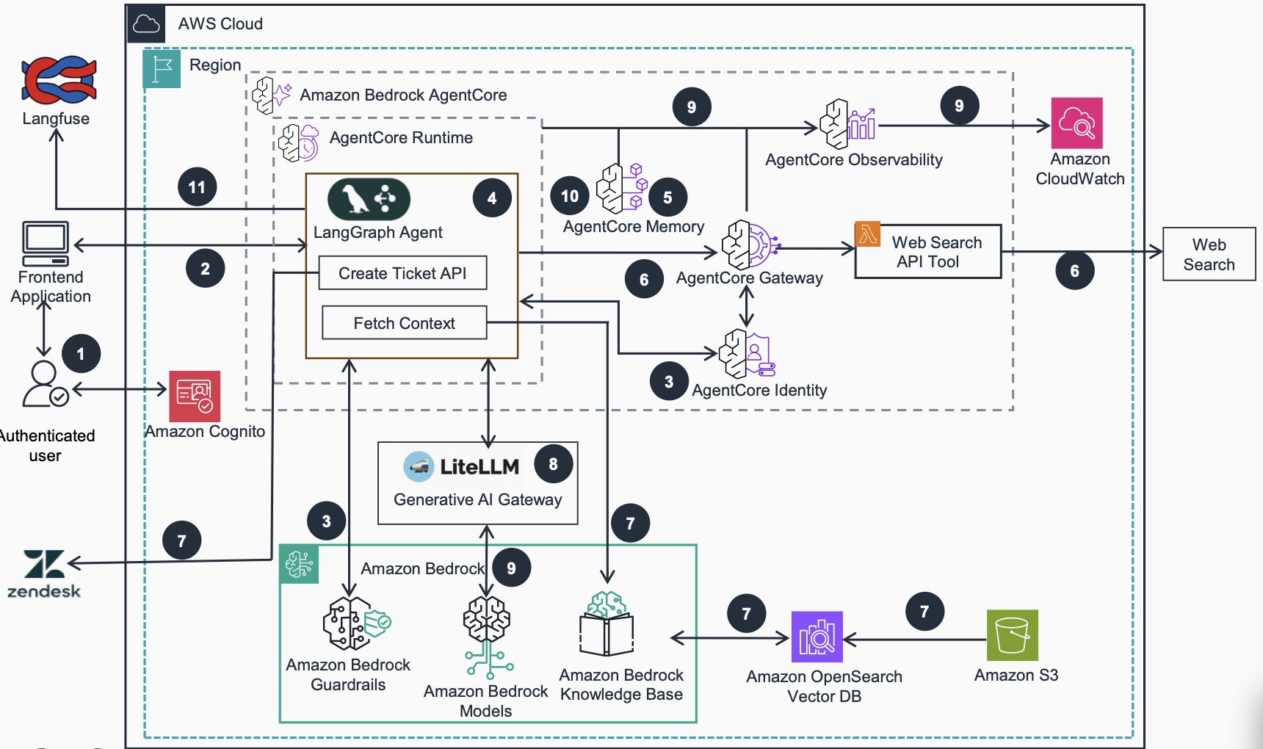
Example Foundational Agentic Architecture
GOVERNING AGENCY
Confidential
Notes:
Identity & Access: Amazon Cognito authenticates users before they ever reach the agent. AgentCore Identity (step 3) manages what the agent itself is authorized to do, separating user identity from agent identity.
Gateway as Control Point: AgentCore Gateway (step 6) acts as the chokepoint between the agent and external tools (like web search). This is where you enforce policies on what the agent can call and how data flows in/out.
Guardrails: Bedrock Guardrails sit in front of the models to filter inputs/outputs: such as content filtering, topic blocking, PII redaction before anything hits the LLM.
Observability & Audit: AgentCore Observability (step 9) feeds into CloudWatch, plus Langfuse (step 11) provides an external trace layer. This gives you full audit trails of every agent action and decision.
Memory Governance: AgentCore Memory (step 5) centralizes what the agent retains, giving you a single place to manage data retention and context boundaries rather than letting state scatter across services.
In short — it's the "harness architecture" we were just talking about. Every layer between the user and the external world is a security control point.

Slide 28
Executive Summary
GOVERNING AGENCY
AI agents are being built and delivered as enterprise-ready, not experimental
Reduce cost-to-serve, scale global support, and accelerate time-to-resolution
Built-in governance, audit trails, PII protection, and compliance readiness
Guidance for development is still tried and true: Start with a focused pilot, measure outcomes, and scale securely with confidence
Confidential

Slide 29
QUESTIONS?

